Slide 1
Fun with Home Prices
Ben Rohlfing
STAT 490
Final Project

Slide 2
Initial Dataset
Data are selling home prices from King County, Washington on homes sold from May 2014 to May 2015
Initially 21 predictors, including:
Number of bedrooms/bathrooms
Square footage of the house
Condition of the house
Construction quality of the house
Year it was built/renovated
Latitude/longitude of the house
Trying to find out what factors lead to increased home selling prices in King County

Slide 3
Adjusting the Dataset
Removed house id
Removed outlier point that had 33 bedrooms – likely typo
For year built, subtracted year house was sold by year it was built
For year renovated:
If house wasn’t renovated, this value would equal the year it was built
Otherwise, subtracted current year by year it was renovated
For square footage of lot and square footage of lot of nearest 15 houses, performed a 1/X transformation based on distribution shape

Slide 4
Adjusting the Dataset
Created dummy variables for latitude and longitude
Latitude
Picked 47.5 degrees as cutoff
North of this was denoted as 1 (includes city of Seattle)
South of this was denoted as 0 (includes everything south of city)
Longitude
Picked -122.1 degrees as cutoff
West of this was denoted as 1 (urban part of King County)
East of this was denoted as 0 (rural part of King County)
Created predictor bed_bath_ratio by dividing bedrooms by bathrooms

Slide 5
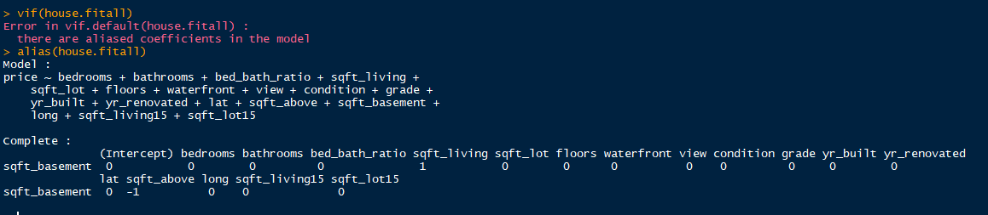
Initial Fit
Initial fit had most predictors significant
Found out sqft_living and sqft_above are linear dependencies
Decided to eliminate one of them
RMSE = 198,984

Slide 6
Reducing the model
Ridge regression and LASSO were run to determine which is more significant to the model: sqft_living or sqft_above
Both methods had RMSE of around 195,000
Both methods suggested eliminating sqft_above well before sqft_living
Thus, decided to eliminate sqft_above from model along with sqft_basement since these two add up to sqft_living

Slide 7

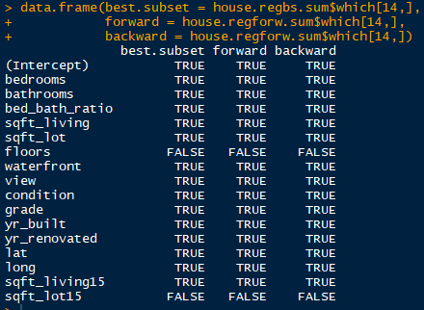
Feature Selection
Best subset selection, forward selection, and backward selection were performed without sqft_above and sqft_basement (16 predictors)
Metrics of adjusted R squared, Cp, and BIC were calculated for each feature selection method
Every method/metric combination suggested the use of 14 predictors in the reduced model
All suggest floors and sqft_lot15 should be eliminated

Slide 8
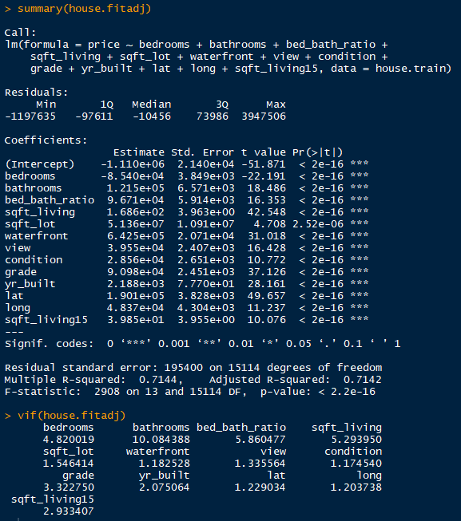
Adjusted Model
Adjusted model after eliminating sqft_lot15 and floors
Also eliminated yr_renovated due to its insignificance
First one removed in ridge/LASSO rerun with 16 predctors – RMSE about same as first run
Would have been eliminated if only 13 predictors were chosen in feature selection
Most coefficients seem normal
Abnormal: bathrooms and yr_built
Further investigation needed – possible multicollinearity
Possible with bedrooms, not so with yr_built

Slide 9
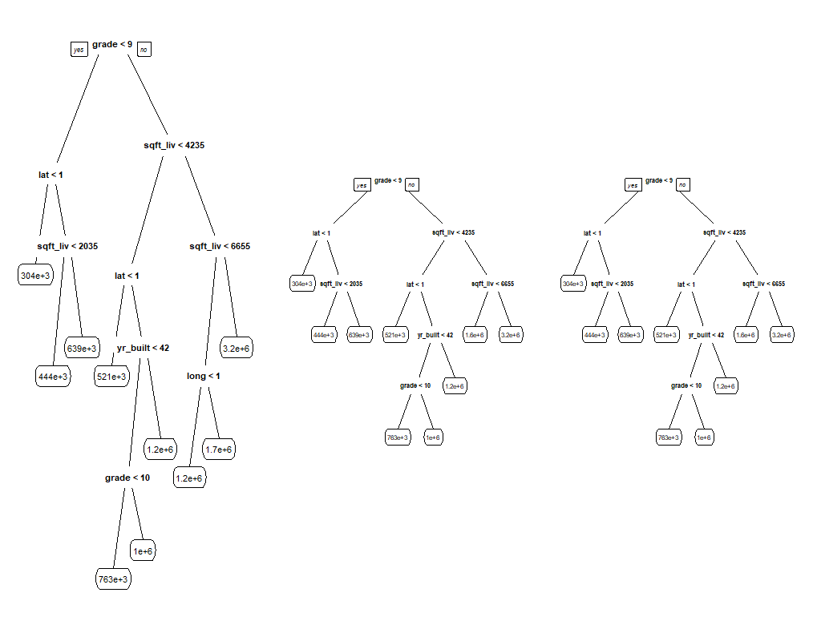
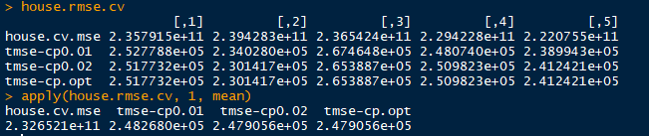
Regression Trees
Developed regression tree – suggested grade, sqft_living, lat as some of most important predictors
Was able to prune tree from 9 branches to 8 branches
Performed 5-fold CV on each tree – significantly underestimated test RMSE

Slide 10
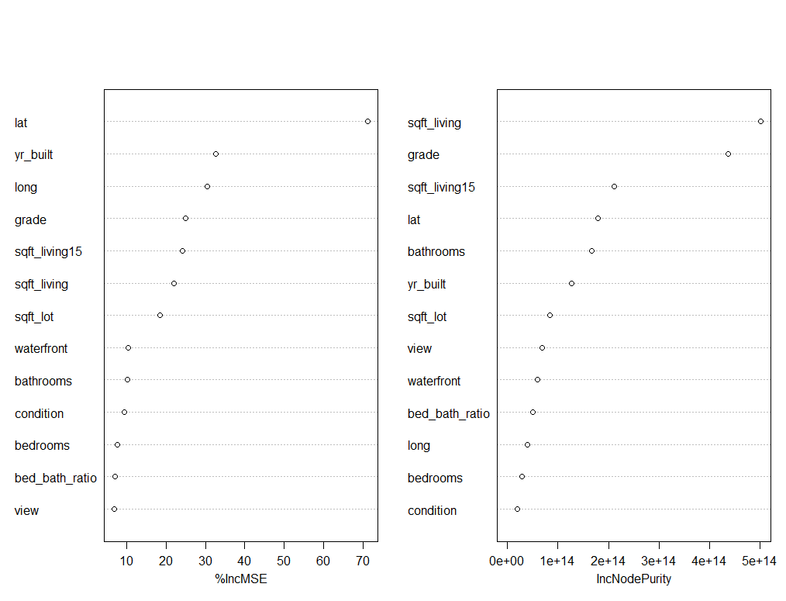
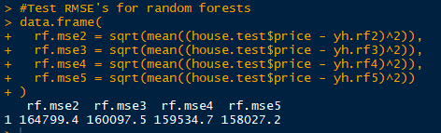
Random Forests
Ran random forests with number of predictors randomly selected at each node varying from 2 to 5 with 150 trees generated for each forest
Caclulated test RMSE for each forest – reduced by a significant amount
Lat/long are two of most important predictors – staying in final model
Bedrooms, bathrooms, and bed_bath_ratio differ little in importance – not eliminating any of them based on this

Slide 11
Final Model
Ran ridge/LASSO one more time on remaining 13 predictors to try and eliminate bed/bath predictors or anything else
Suggested bed_bath_ratio was least important of three, so tried eliminating that from the final model
Mulitcollinearity went away, but bedrooms coefficient still negative
Only whenever I eliminated bathrooms, bed_bath_ratio, and especially sqft_living did the bedrooms coefficient become positive, suggesting possible multicollinearity issues with sqft_living
Since sqft_living has been one of the most significant predictors throughout this process, decided to drop bedrooms and bathrooms from the final model
Also decided to remove sqft_lot from final model as well, considering its relative nonsignificance in adjusted model and with it being one of the first predictors eliminated on each run through ridge/LASSO

Slide 12
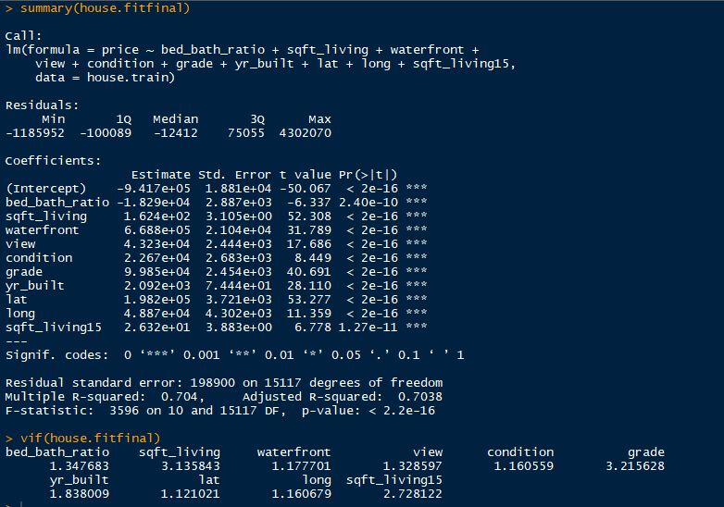
Final Model
Every coefficient except yr_built makes sense
Couldn’t find a reason for this
Significant throughout, so kept in final model
R-squared barely dropped while adding simplicity to the model
Little multicollinearity issues appear to be left

Slide 13
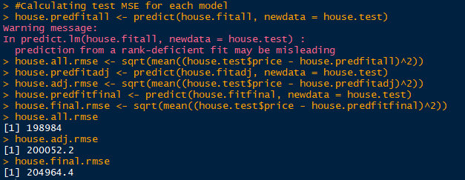
Model Validity
Calculated the test RMSE for each of the three models that were fit using the test data
Little change in test RMSE from model to model: not great, but expected given slight decrease in R-squared as predictors were being removed

Slide 14
Inferences
Interpretations for some of the most significant predictors:
Grade: While holding all other predictors fixed, as the grade of construction of the house goes up by one point, the price of a home goes up by about $98,850.
Sqft_living: While holding all other predictors fixed, as the square footage of a house goes up by 1 foot, the price of a house goes up by about $162.40.
Lat: While holding all other predictors constant, as the house goes from the southern part of the county to the northern part of the county, the selling price of the house will go up by about $198,200. (wow)
Long: While holding all other predictors constant, as the house goes from the eastern part of the county (rural) to the western part of the county (urban), the selling price of the house will go up by about $48,870.

Slide 15
Inferences
Latitude and longitude especially intriguing – became more significant after turning them into dummy variables by delineating them by region
Still can’t fully explain yr_built predictor
Possible factors missed in the final model, including:
Year it was renovated – Removed due to insignificance
Specific neighborhoods houses were in – hard to pin down, even with zipcodes
Other factors that weren’t accounted for in the final model

Slide 16
Limitations
Yr_built factors unaccounted for in this study
With keeping latitude and longitude in final model, this model only works with King County due to layout of significant features within the county
A more general model for home selling price (different region, bigger region) probably would have discarded latitude and longitude entirely

